Slide 1
Problem Statement
Predict the risk of heart strokes based on some features and categorise it as high or low.

Slide 2
MOTIVATION
The maximum number of deaths(23.4%) are caused by heart attacks.
By predicting the risk of heart stroke and on analysing the data, we can suggest certain changes in the lifestyle of the people with high risk of heart stroke.
This can increase the life expectancy of that person

Slide 3
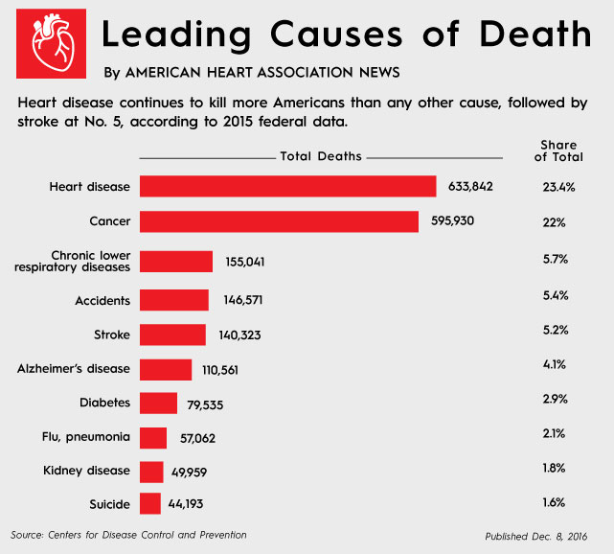

Slide 4
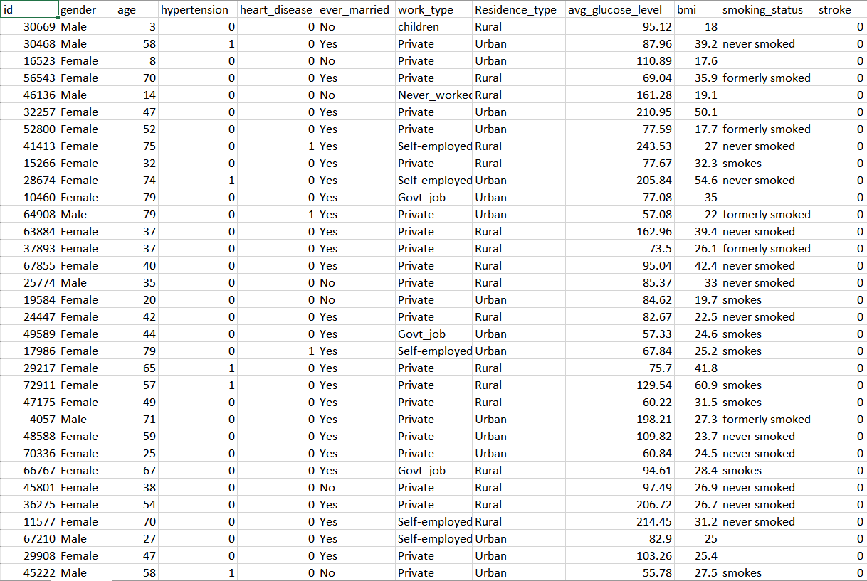
THE DATASET

Slide 5
PRE-PROCESSING OF THE DATA
Pre-processing of the data is the first and one of the most crucial stage in data analytics and before applying learning algorithms.
Data cleaning - Removing irrelevant information
Data Balancing
Splitting up of data into training data and test data
Label Encoding
Vectorization

Slide 6
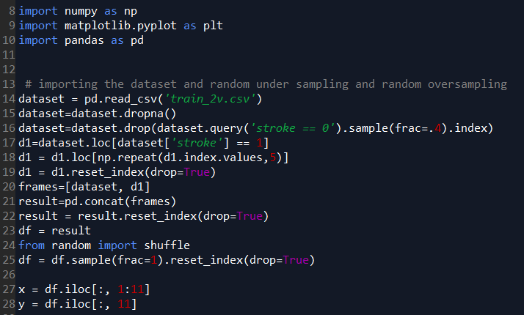
DATA BALANCING
The data was highly skewed
towards the negative class
and this could lead to misclassification
of the data. This problem can be overcome by
Using the following techniques
Technique used :
Random Under Sampling
Random Over Sampling

Slide 7
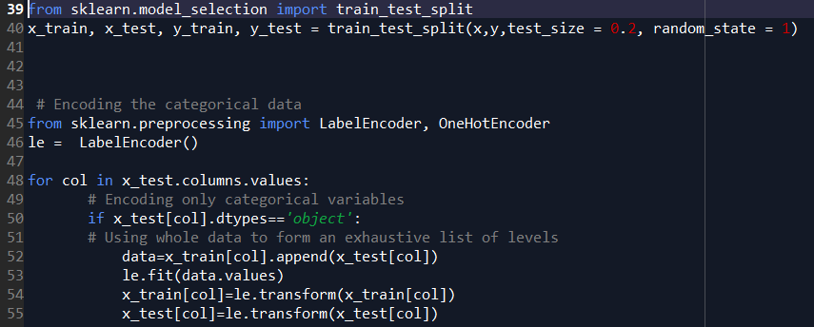
LABEL ENCODING

Slide 8
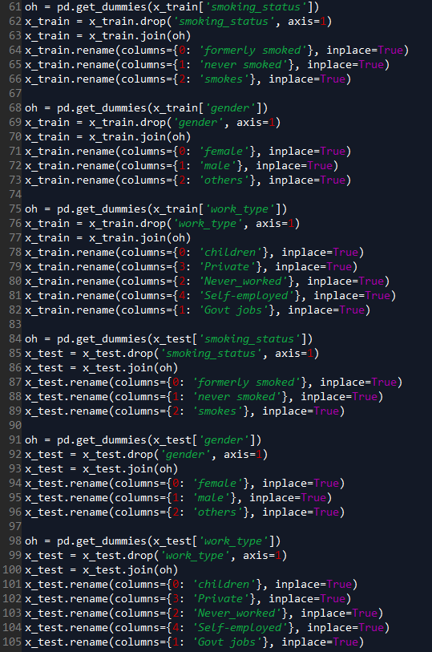
VECTORIZATION
One hot Encoder
We create multiple columns
equal to the number of
Categories in that feature
And label them 1 if they are
Present and as 0 if absent

Slide 9
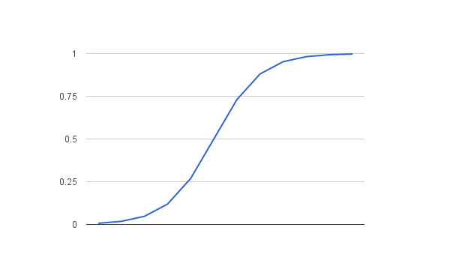
Model 1 – Logistic Regression
Intuition:
Popular for binary classification
Wide range of problems
Model fits the problem
Concept behind:
Logistic function
defined as:
1/(1+e^-x)

Slide 10
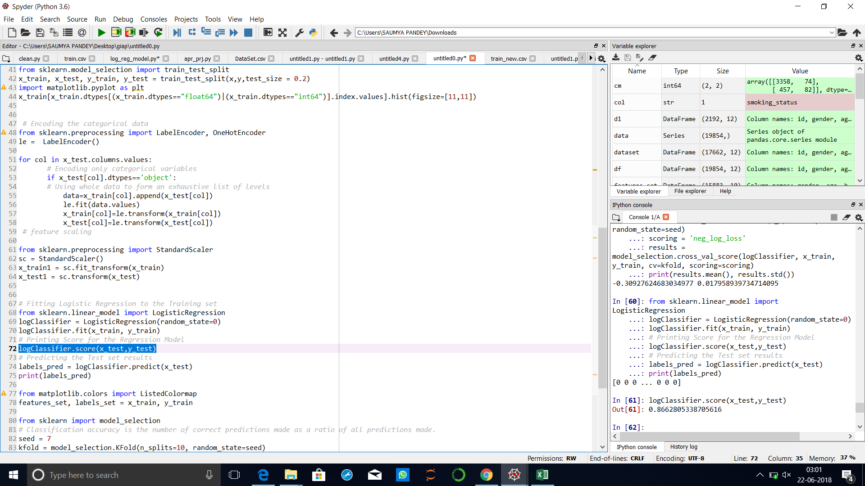
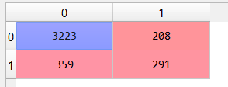
Accuracy and confusion matrix obtained:

Slide 11
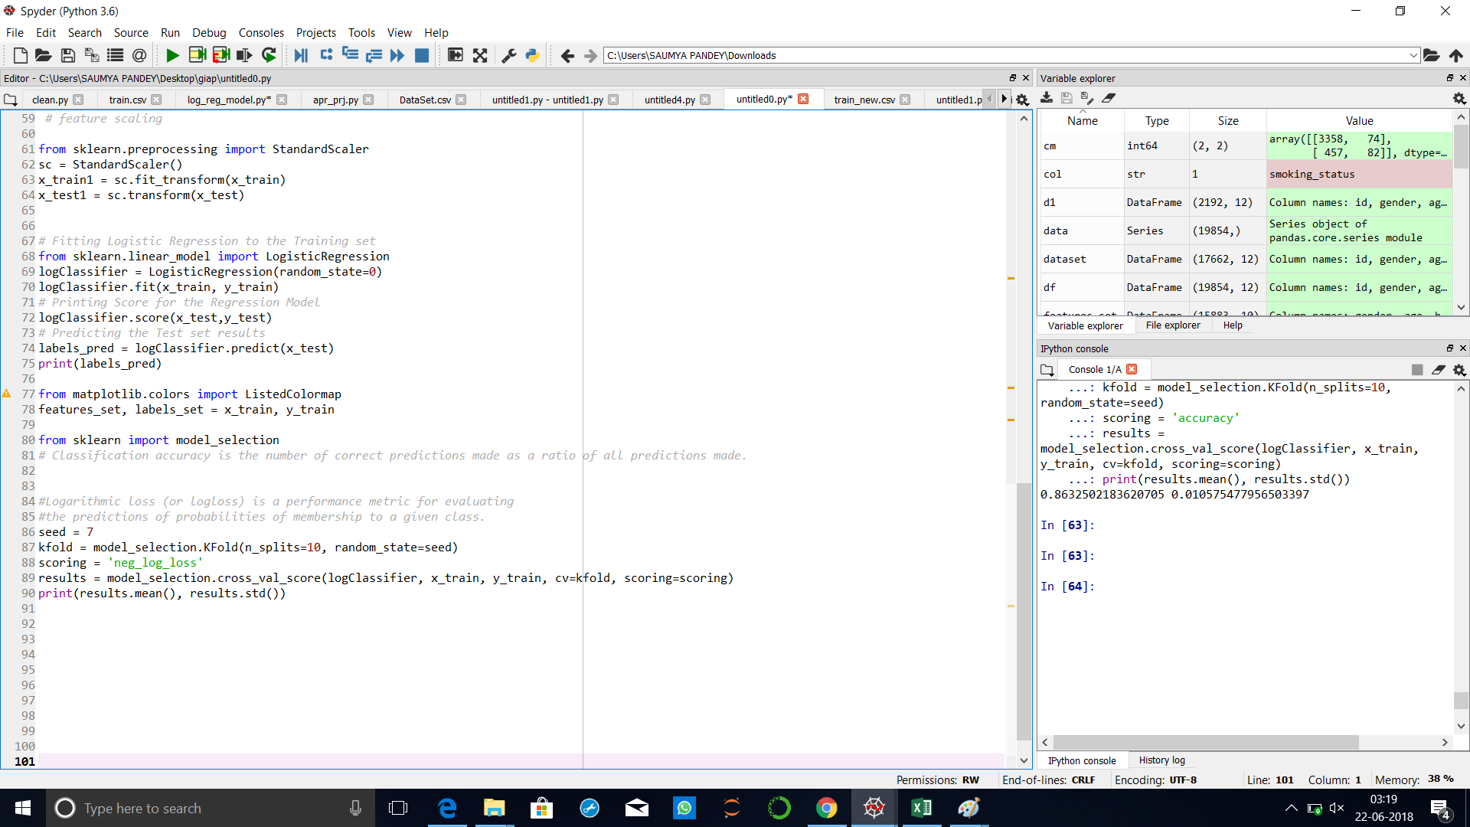
Ensuring the accuracy:

Slide 12
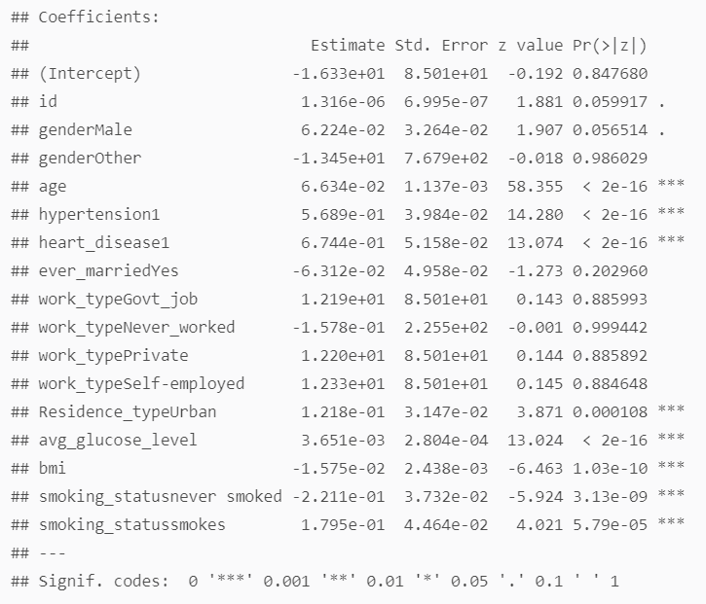

Slide 13
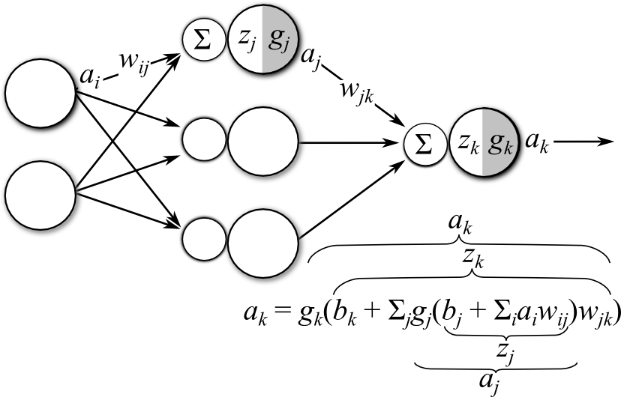
Neural Net

Slide 14
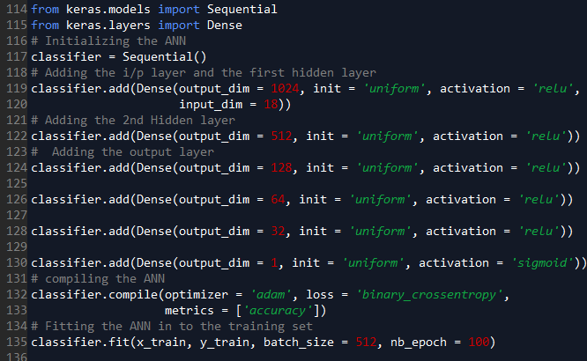
Architecture

Slide 15
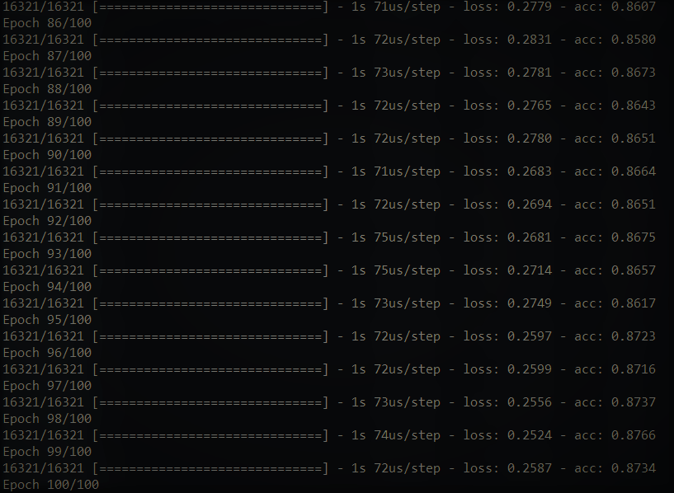
Prediction and metrics

Slide 16
Support vector machine
Supervised learning models that analyze data used for classification and regression analysis.
SVM uses hyperplane to separate two classes.
SVM’s can efficiently perform a non-linear classification using what is called the kernel trick (mapping the inputs into high-dimensional feature spaces)

Slide 17
Examples of Kernel Functions
Linear: K(x_{i},x_{j})= x_{i} ^{T}x_{j}
Polynomial of power p: K(x_{i},x_{j})= (1+ x_{i} ^{T}x_{j})^{p}
Gaussian (radial-basis function network):
Sigmoid: K(x_{i},x_{j})= tanh(β₀x_{i} ^{T}x_{j} + β₁)

Slide 18
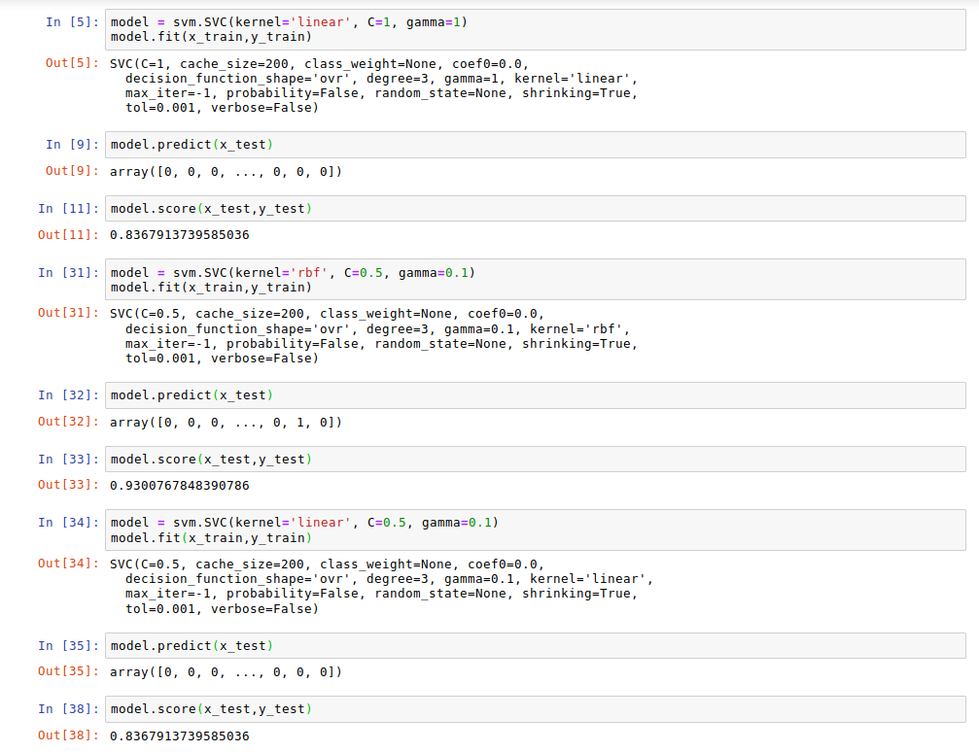

Slide 19
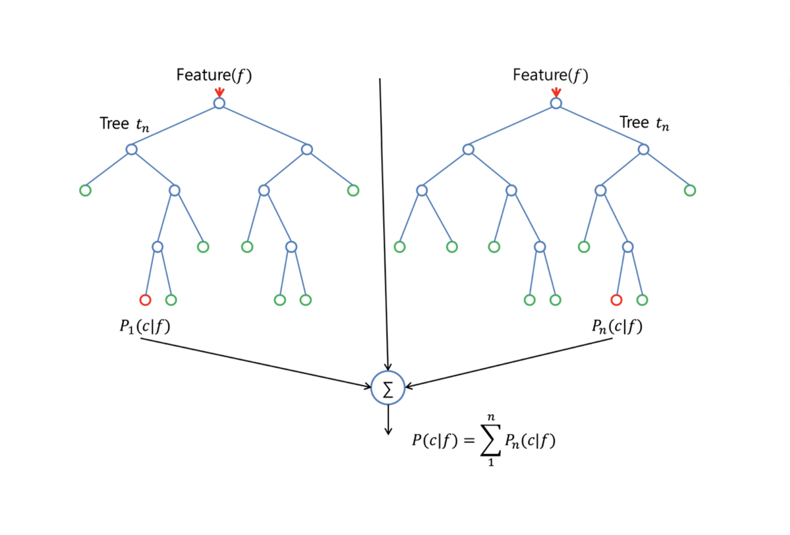
Random Forest
Used for regression and classification
A random subset of the features is considered for splitting a node
Builds multiple decision trees and merges them together to get a more accurate and stable prediction.

Slide 20
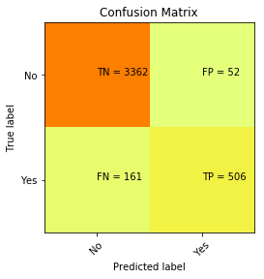
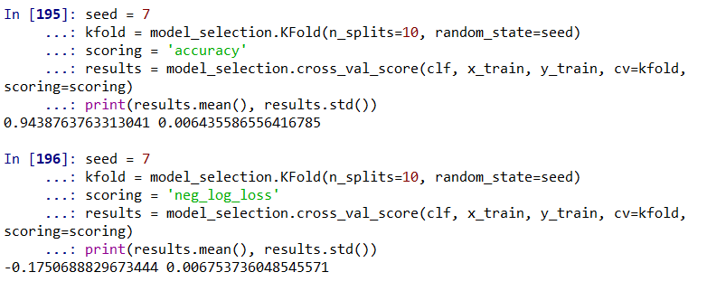
RESULTS
Confusion matrix
Accuracy and log loss values

Slide 21
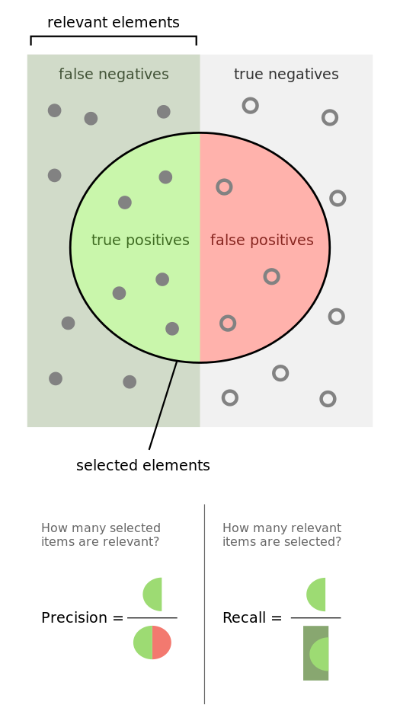
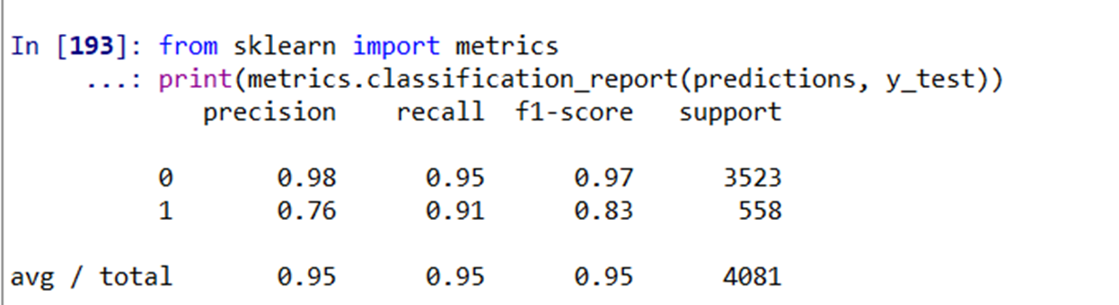
Classification Report
F1 Score is the weighted average of Precision and Recall

Slide 22
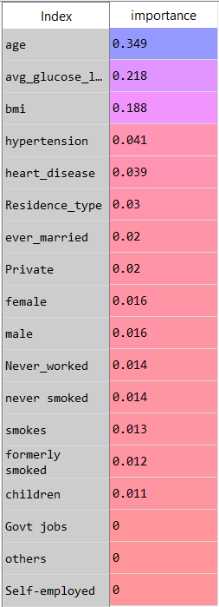
Feature Importance
Easy to measure using RF
Inference :
Important parameters for prediction of stroke are age, average glucose levels, body mass index

Slide 23
Summary
Comparison of the Accuracies:
Random Forest : 94.37%
Support Vector Machine:93.0%
ANN:87.19%
Logistic Regression:86.6%

Slide 24
Main contributors for the heart stroke:
Age
Avg. Glucose Level
BMI
Hypertension
Smoking
Heart Disease

Slide 25
Thank You

